Slide 1


Slide 2

Contents
Introduction
Need of pipelining
Performance Evaluation

Slide 3
Introduction
Pipelining is a technique of decomposing a sequential process into sub operations, with each subprocess being executed in a special dedicated segment that operates concurrently with all other segments.
The result obtained from the computation in each segment is transferred to the next segment in the pipeline.
The final result is obtained after the data have passed through all segments.
Dr. Bhoopesh Singh Bhati

Slide 4
Need of Pipelining
A parallel processing system is able to perform concurrent data processing to achieve faster execution time
The system may have two or more ALUs and be able to execute two or more instructions at the same time
Helps by increasing the throughput i.e., the amount of processing that can be accomplished during a given interval of time
Dr. Bhoopesh Singh Bhati

Slide 5
Example
Question. Consider a 4-segment pipeline to execute 4 tasks. Compare the number of cycles required in a pipelined model, and a non-pipelined model.
CASE 1: Pipelined
Only 7 cycles used.
O/P |  |  |  | T1 | T2 | T3 | T4
S1 |  |  |  | T1 | T2 | T3 | T4
S2 |  |  | T1 | T2 | T3 | T4
S3 |  | T1 | T2 | T3 | T4
S4 | T1 | T2 | T3 | T4
 | 1 | 2 | 3 | 4 | 5 | 6 | 7 | 8 | 9
Dr. Bhoopesh Singh Bhati

Slide 6
Example contd…
Question. Consider a 4-segment pipeline to execute 4 tasks. Compare the number of cycles required in a pipelined model, and a non-pipelined model.
CASE 2: Pipelined
16 cycles used.
 |  |  |  | T1 |  |  |  | T2 |  |  |  | T3 |  |  |  | T4
S1 |  |  |  | T1 |  |  |  | T2 |  |  |  | T3 |  |  |  | T4
S2 |  |  | T1 |  |  |  | T2 |  |  |  | T3 |  |  |  | T4
S3 |  | T1 |  |  |  | T2 |  |  |  | T3 |  |  |  | T4
S4 | T1 |  |  |  | T2 |  |  |  | T3 |  |  |  | T4
 | 1 | 2 | 3 | 4 | 5 | 6 | 7 | 8 | 9 | 10 | 11 | 12 | 13 | 14 | 15 | 16
Dr. Bhoopesh Singh Bhati

Slide 7
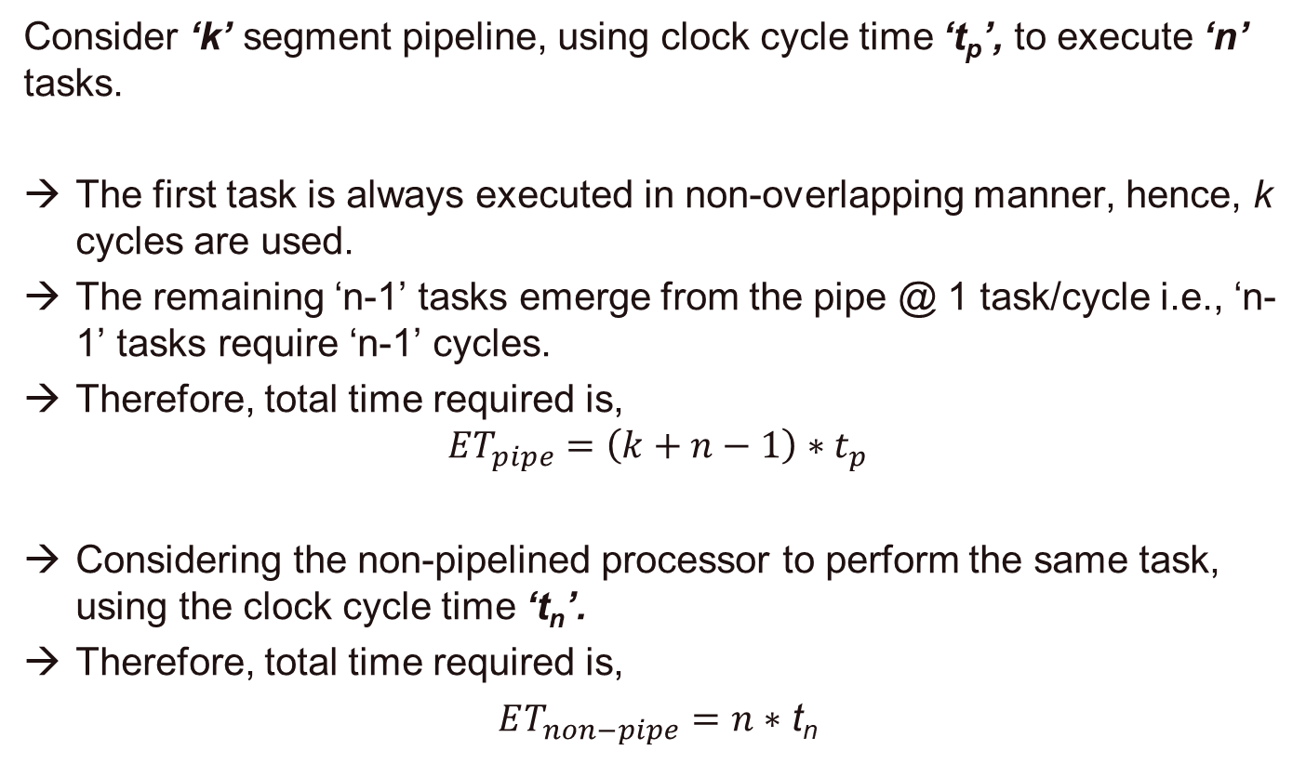
Performance Evaluation
Consider ‘k’ segment pipeline, using clock cycle time ‘t_{p}’, to execute ‘n’ tasks.
The first task is always executed in non-overlapping manner, hence, k cycles are used.
The remaining ‘n-1’ tasks emerge from the pipe @ 1 task/cycle i.e., ‘n-1’ tasks require ‘n-1’ cycles.
Therefore, total time required is,
$$ET_{pipe}=\left(k+n−1\right)∗t_{p}$$
Considering the non-pipelined processor to perform the same task, using the clock cycle time ‘t_{n}’.
Therefore, total time required is,
$ET_{non−pipe}=n∗$ t_{n}
Dr. Bhoopesh Singh Bhati

Slide 8
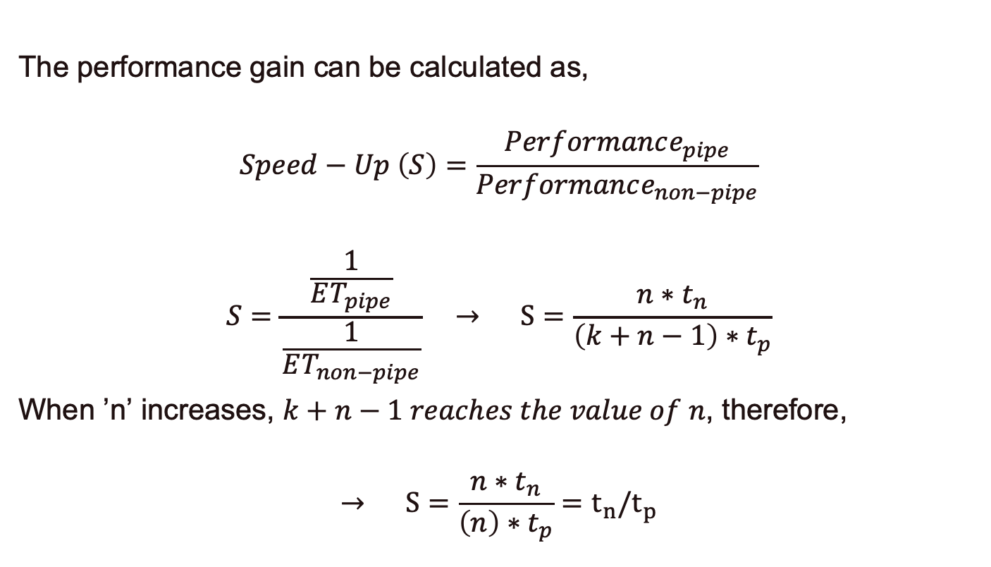
Performance Evaluation
Contd…
The performance gain can be calculated as,
$$Speed−Up \left(S\right)=\frac{Performance_{pipe}}{Performance_{non−pipe}}$$
$$S=\frac{\frac{1}{ET_{pipe}}}{\frac{1}{ET_{non−pipe}}} → S=\frac{n∗t_{n}}{\left(k+n−1\right)∗t_{p}}$$
When ’n’ increases, $k+n−1 reaches the value of n$, therefore,
$$→ S=\frac{n∗t_{n}}{\left(n\right)∗t_{p}}=t_{n}/t_{p}$$
Dr. Bhoopesh Singh Bhati

Slide 9
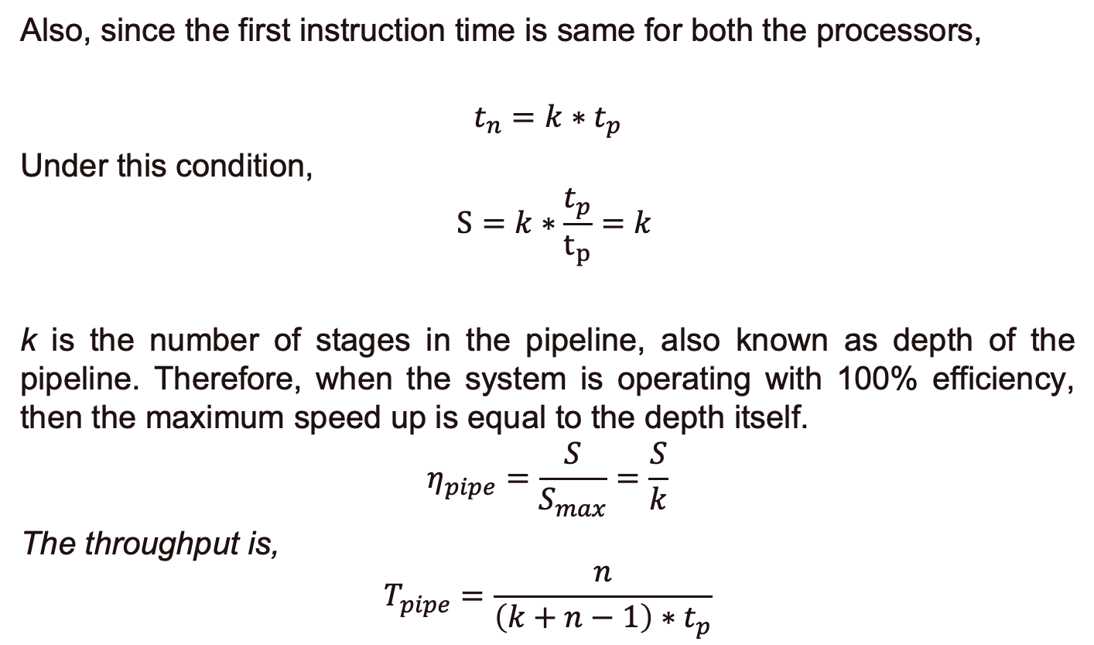
Performance Evaluation
Contd…
Also, since the first instruction time is same for both the processors,
$$t_{n}=k∗t_{p}$$
Under this condition,
$$S=k∗\frac{t_{p}}{t_{p}}=k$$
k is the number of stages in the pipeline, also known as depth of the pipeline. Therefore, when the system is operating with 100% efficiency, then the maximum speed up is equal to the depth itself.
$$η_{pipe}=\frac{S}{S_{max}}=\frac{S}{k}$$
The throughput is,
$$T_{pipe}=\frac{n}{\left(k+n−1\right)∗t_{p}}$$
Dr. Bhoopesh Singh Bhati

Slide 10
Thank You

